Slide 1
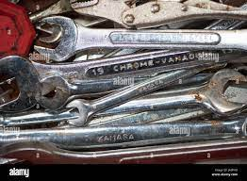
2.Service of vehicle
(tools and materials)
Tools
1.Spanners
-It is used for loosening and tightening of bolts and nuts.

Slide 2
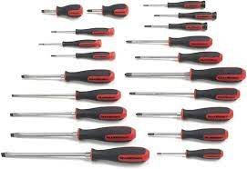
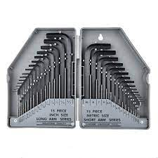
2.Screwdrivers
-It is used for loosening and tightening of screws.
-It is used for loosening and tightening of bolts & nuts.
3.Allen keys
-It is used for loosening and tightening of bolts & nuts.

Slide 3

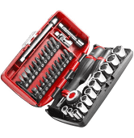
4.Cordless drill
-It is used for loosening and tightening of screws.
-It is used for loosening and tightening of bolts & nuts.
5.Sockets
-It is used for loosening and tightening of screws.
-It is used for loosening and tightening of bolts & nuts.

Slide 4
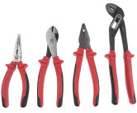
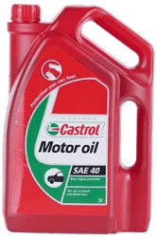
6.Pliers
-They are used as cutting tools, removing and replacing of clamps etc.
Materials
1.Engine oil
- It is used as a lubricant.

Slide 5

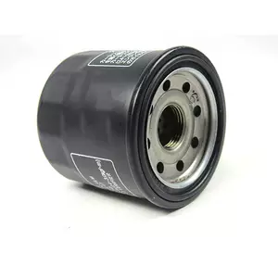
2.Air filter
- It traps dust particles from inflow air.
3.Oil filter
- It traps impurities from the oil or lubricant.

Slide 6


4.Spark plugs
- It ignites the mixture of petrol and air.
5.Anti freeze
- It prevents coolant from freezing.

Slide 7
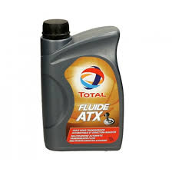
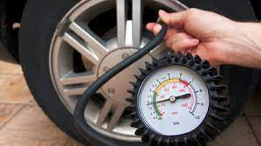
6.Transmission fluid
It provides hydraulic pressure and friction to make internal parts work in gearboxes and
In power steering pumps etc.
7.Tyre Pressure
- It inflates air into the tyres.

Slide 8
Feedback
Activity : Worksheet 2
Kwa Thema Skills School
Subject : Maintenance Marks : 10
Grade : Year 2 Time : 30mins
Date :
Question:1
1.Name the following marking and cutting hand tools.
1.1 _________________________
1.2 _________________________
1.3 _________________________
1.4 _________________________
1.5 _________________________
2. Name five materials are used when servicing engine of a vehicle
2.1 _________________________
2.2 _________________________
2.3 _________________________
2.4 _________________________
2.5 _________________________

